Slide 1

INFORMATION
GUIDE
Incoming students
WINTER SEMESTER 2026/2027
International Cooperation Office
Faculty of Humanities and Social Sciences
University of Zagreb
WELCOME TO ZAGREB
Notes:
[Sources]
- Visual on this slide was generated with Microsoft Copilot.
[/Sources]

Slide 2
FIRST STEPS
Your student card: IKSICA
Two cards, one simple handover process.
01
Temporary IKSICA
02
Personal IKSICA
03
Activate & return
Valid from the start of the academic year. Use it until your personal card is ready.
Usually issued within 2 weeks. Collect it at the Info Centre.
Go to the Student Administration Office, contact Ms Izidora Herold, to activate the new card and return the temporary one.
KEEP YOUR TEMPORARY CARD UNTIL THE HANDOVER

Slide 3

CAMPUS SERVICES
Library access
Bring the right documents and enrol at an information desk.
Who can enrol?
Guest students with an active AAI@EduHr electronic identity.
BRING
GO TO
• IKSICA
• AAI@EduHr credentials
• Passport or ID
Central Information Desk
Library ground floor
or any information desk on each floor
Notes:
[Sources]
- Visual on this slide was generated with Microsoft Copilot.
[/Sources]

Slide 4
ACADEMIC ADMINISTRATION
Learning Agreement: OLA / LA
3-WEEK CHANGE PERIOD
Use the first 3 weeks to finalise your course list.
01
Discuss courses
02
Collect approvals
03
Institutional signature
Arrange course choices and changes with the relevant departmental ECTS or CEEPUS coordinator(s).
Obtain approval for every change from your departmental coordinator(s).
The International Cooperation Office provides the institutional signature, in EWP or handwritten. Send the correct LA form for your exchange programme to incoming@m.ffzg.hr.

Slide 5
AFTER THE CHANGE PERIOD
Final enrolment form
Complete the Excel table so your courses can be registered.
1
FINALISE
2
ENTER
3
SEND
4
CHECK
After 3 weeks, confirm your final course list.
List all courses in section 3 of the enrolment Excel table.
Complete the final section and email it to incoming@m.ffzg.hr.
Courses will appear in ISVU and Studomat after registration.
→
→
→
Important: courses not confirmed on time will not be available in Studomat.

Slide 6

PLAN YOUR SEMESTER
Academic information
Keep your schedule, catalogue and coordinator contacts in one place.
Class schedule
Ask your departmental coordinator for the updated schedule and consultation times.
web2020.ffzg.unizg.hr/studiji/raspored/
Course catalogue
Browse courses available to guest students.
web2020.ffzg.unizg.hr/international/guest-students/course-catalogue/
Departmental coordinators
Find ECTS and CEEPUS coordinator contacts.
web2020.ffzg.unizg.hr/international/guest-students/erasmus-students/
Notes:
[Sources]
- Visual on this slide was generated with Microsoft Copilot.
[/Sources]

Slide 7
BEYOND THE TIMETABLE
Language & sports
Two easy ways to connect with campus life.
A
Sports activities
B
Croaticum
Guest students are welcome to join classes at the Section of Kinesiology.
More information:
ffzg.unizg.hr/tzk/nastavnici/
Room B-103, Department of Croatian Language and Literature
Office hours: Monday to Friday
10:00–12:00 and 13:30–15:30
croaticum@ffzg.hr
croaticum.ffzg.unizg.hr

Slide 8
AT THE END OF YOUR STAY
Records & confirmation letters
Know where to request each document.
01
Transcript of Records
02
Other confirmations
Issued at the end of your stay, after the examination period. All grades must be registered in ISVU. Download the transcript from Studomat.
Studomat technical support:
iherold@ffzg.unizg.hr
For confirmation of arrival, departure, attendance and similar letters, contact the student mobility coordinator.
incoming@m.ffzg.hr

Slide 9
WHO TO CONTACT
Student administration
Choose the office that matches your study level.
BA / MA
Student Administration Office
PhD
Postgraduate Studies Office
Undergraduate and graduate students (BA,MA)
Ms Izidora Herold, Head of the Office
iherold@ffzg.unizg.hr
Send an e-mail to schedule the meeting.
Doctoral students (PhD)
Mr Marko Hum, Head of the Office
Ms Anamarija Stipeč
poslijediplomska@ffzg.hr
Send an e-mail to schedule the meeting.

Slide 10
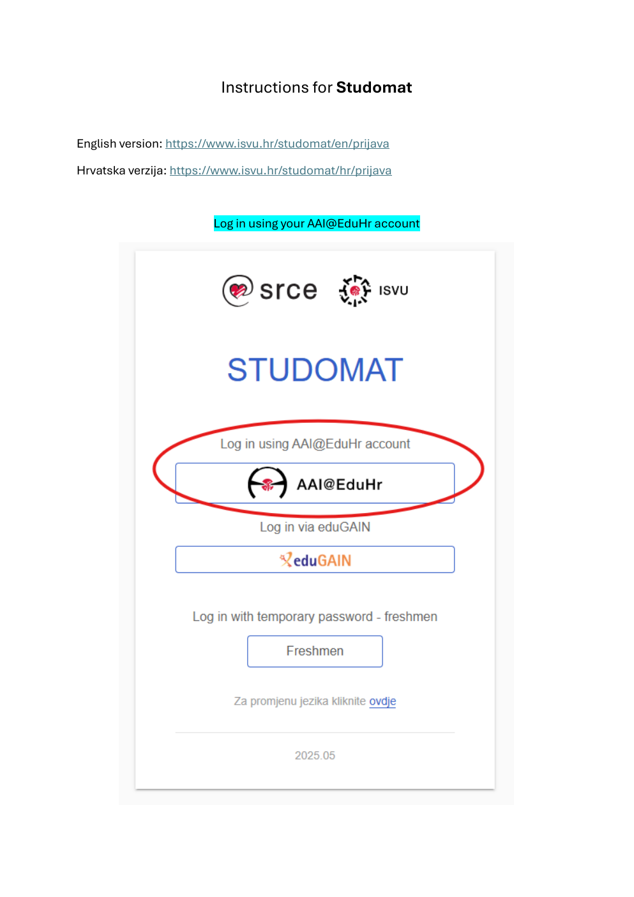
DIGITAL STUDENT SERVICES
Studomat: access & login
Use your AAI@EduHr account to access the student portal.
01
Open Studomat
English version:
www.isvu.hr/studomat/en/prijava
Croatian version:
www.isvu.hr/studomat/hr/prijava
Select “Log in using AAI@EduHr account”.
Notes:
[Sources]
- Source: A - Instructions for Studomat.pdf, page 1.
[/Sources]

Slide 11
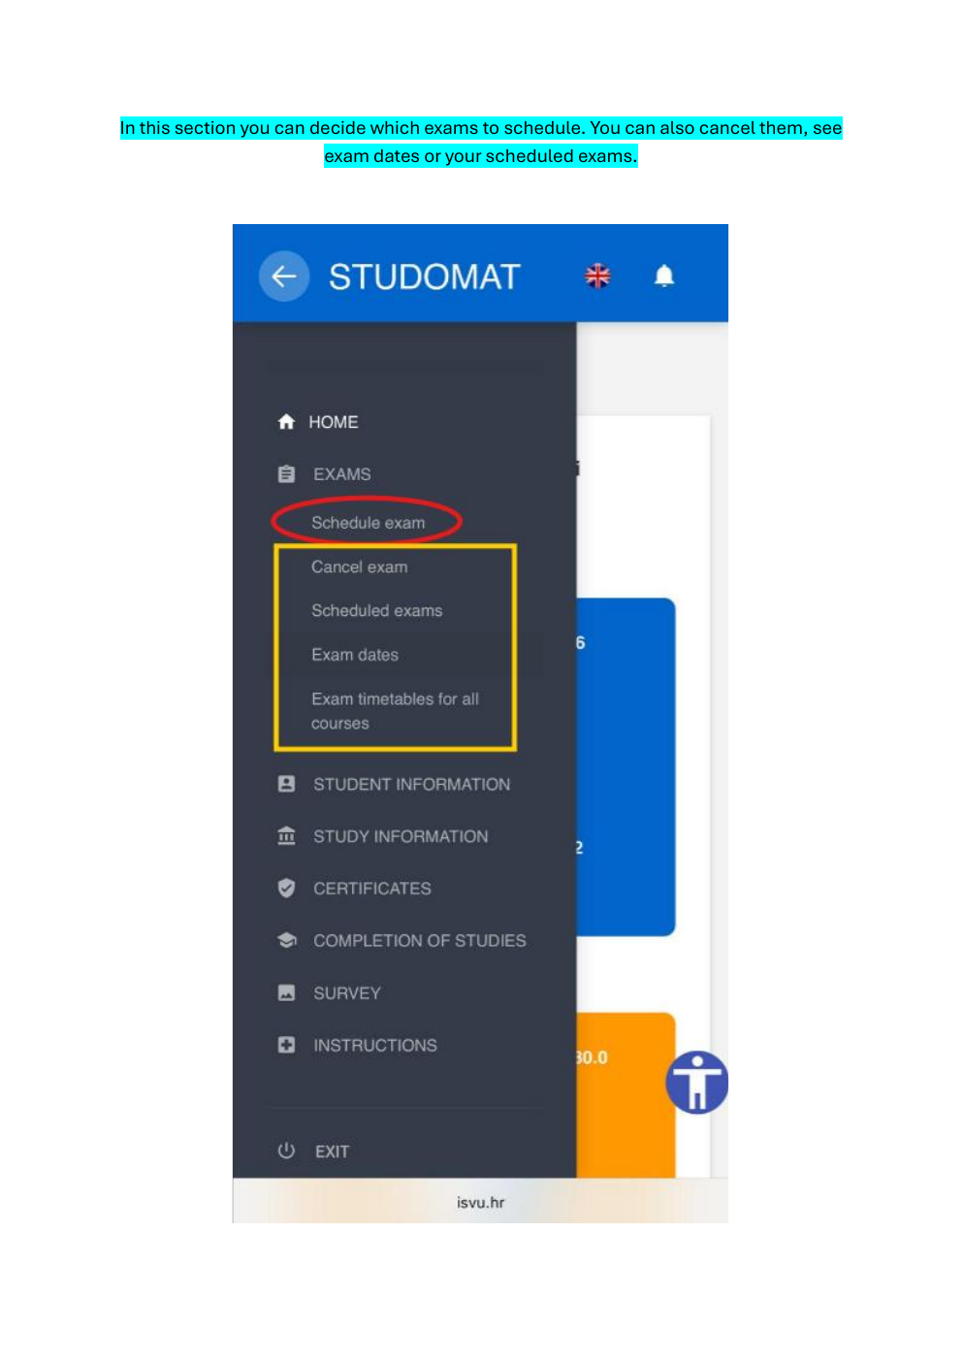
STUDOMAT ESSENTIALS
Exam management
The Exams section brings the main exam actions together.
02
Exams
Use this section to:
• schedule an exam
• cancel an exam
• view scheduled exams
• check exam dates
• view exam timetables for all courses
Notes:
[Sources]
- Source: A - Instructions for Studomat.pdf, pages 2–3.
[/Sources]

Slide 12
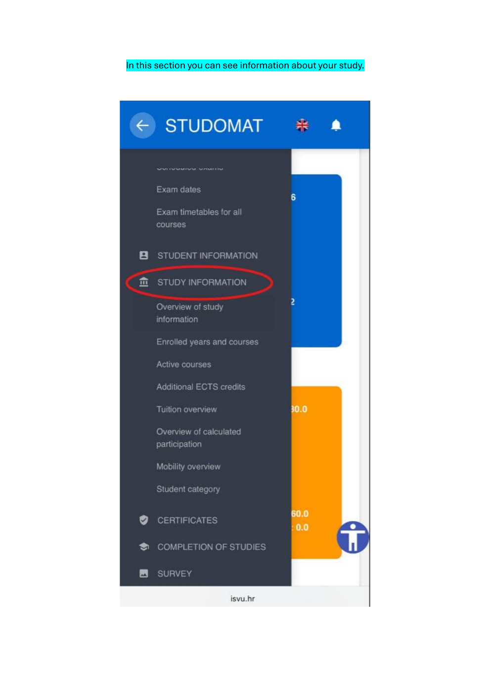
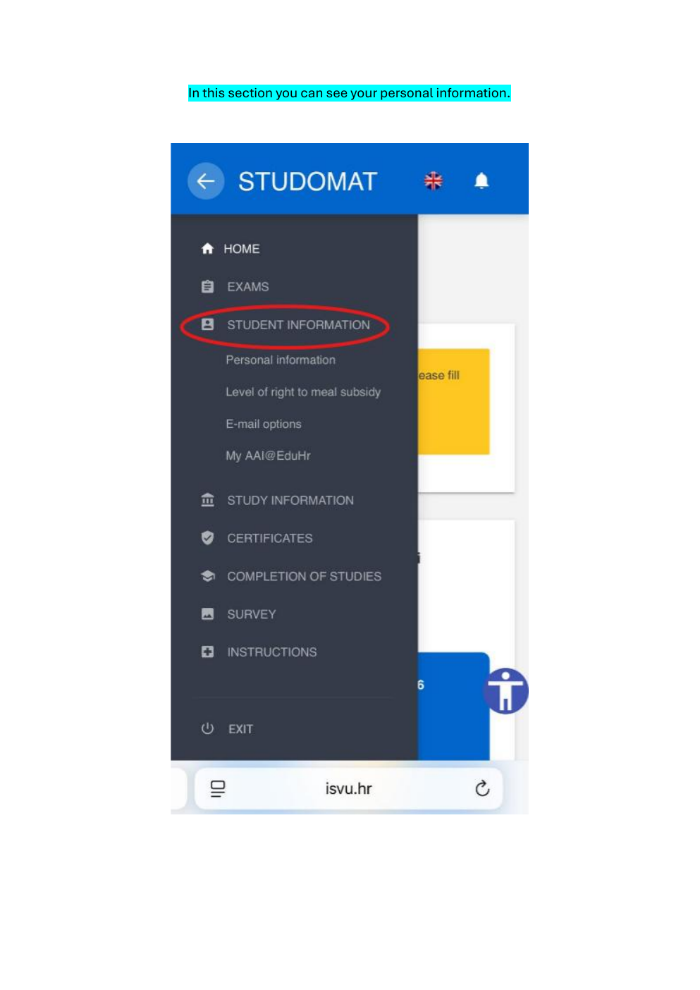
STUDOMAT ESSENTIALS
Study & personal information
Review the information connected to your student record.
03
Study information
View information about your study, including enrolled years, courses and active courses.
04
Student information
View the personal information recorded in Studomat.
Notes:
[Sources]
- Source: A - Instructions for Studomat.pdf, pages 4–5.
[/Sources]

Slide 13
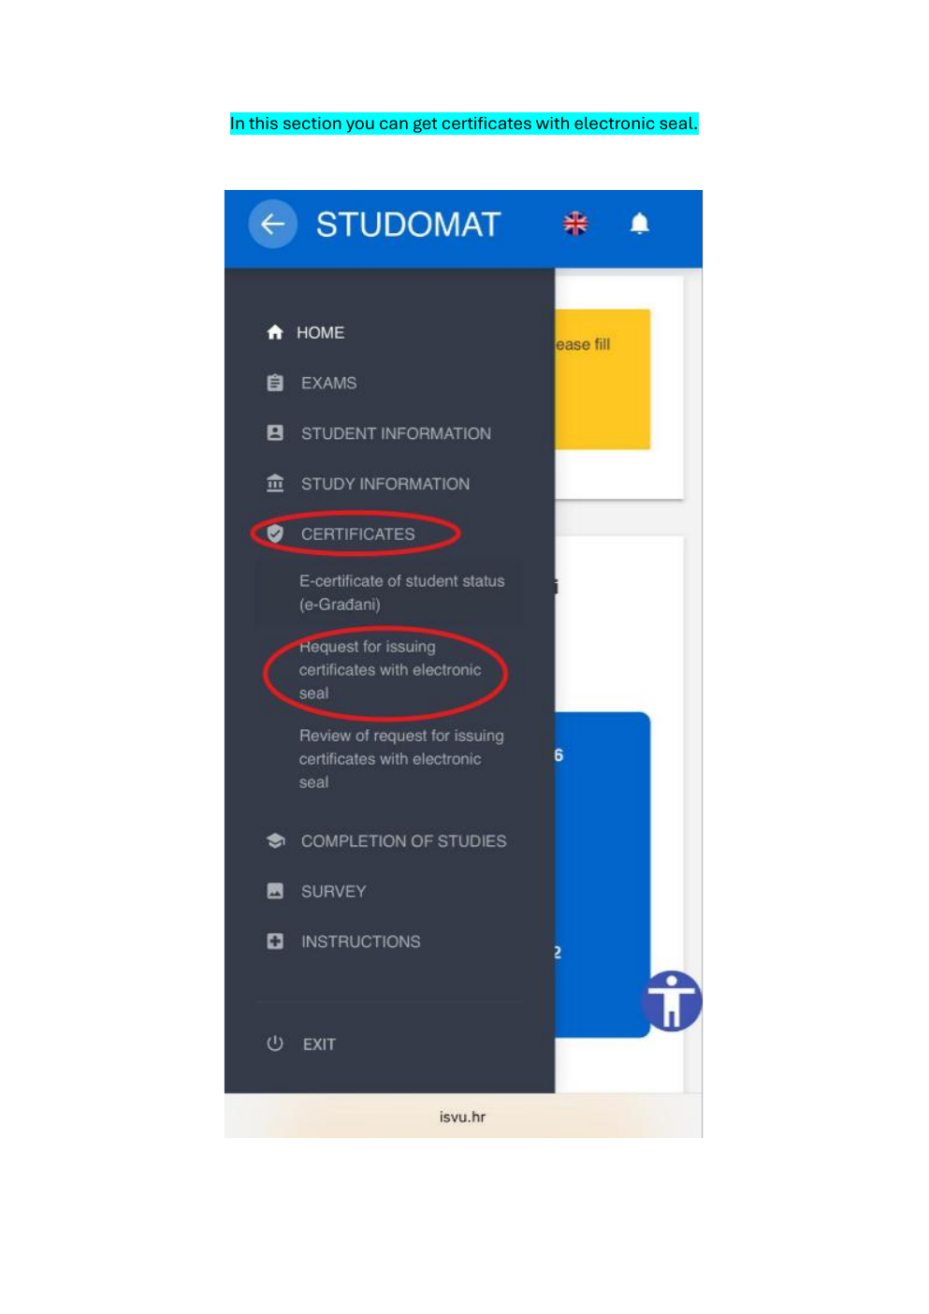
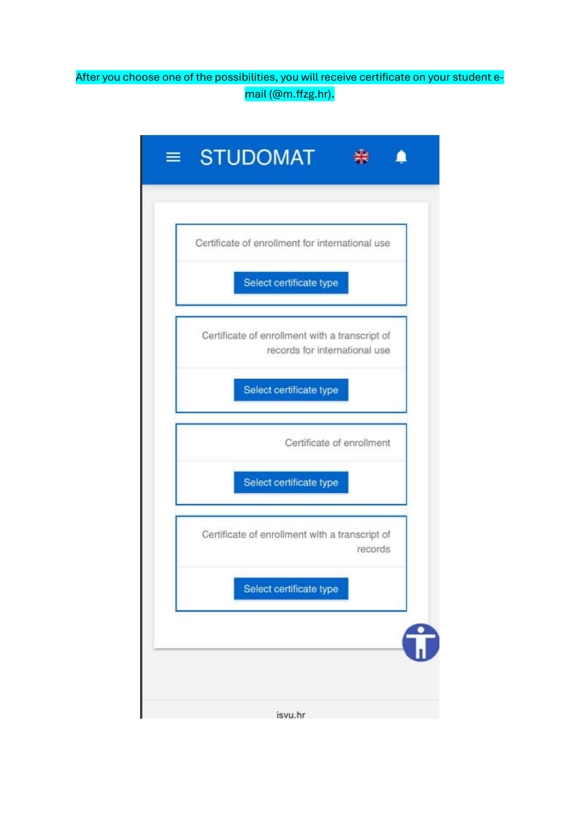
STUDOMAT ESSENTIALS
Certificates with electronic seal
Request a certificate and receive it through your student email.
05
Request a certificate
Open Certificates and select “Request for issuing certificates with electronic seal”. Choose the required certificate type.
The certificate will be delivered to your student email address ending in @m.ffzg.hr.
Notes:
[Sources]
- Source: A - Instructions for Studomat.pdf, pages 6–7.
[/Sources]

Slide 14
WE ARE HERE TO HELP
International
Cooperation Office
STUDENT MOBILITY
Ivana Bedeković
incoming@m.ffzg.hr
+385 1 409 2138
Please contact the office remotely. In-person visits are available when necessary, by prior arrangement.
HEAD OF OFFICE
Tamara Šveljo
tsveljo@ffzg.unizg.hr
OFFICE LOCATION
Library, ground floor
behind the Information Desk
web2020.ffzg.unizg.hr/international

